Slide 1
Digital Portfolio
STUDENT NAME: M. KAYALVIZHI
REGISTER NO. & NMID: 24131241802522015 & 2E9A79CF03F6A43BC534A85EE97C2ED6
DEPARTMENT: B.SC-COMPUTER SCIENCE
COLLEGE: GOVERNMENT ARTS & SCIENCE COLLEGE, VADALORE.

Slide 2
STUDENT DIGITAL PORTOLIO

Slide 3
AGENDA
Problem Statement
Project Overview
Email Users
Tools and Technologies
Portfolio Design and Layout
Features and Functionally
Results and Screenshots
Conclusion

Slide 4
PROBLEM STATEMENT
I aim to create a digital portfolio that showcases my skills, project, and experiences in web development, programming, and other relevant areas.
The portfolio should effectively communicate my strengths and accomplishments to potentia employers, academic institutions, or collaborators, while also serving as a reflection of my growth and progress throughout my academic and professional journey.

Slide 5
PROJECT OVERVIEW
My projects to explain my web page of my portfolio.
Its is clearly explained my details my achievements, and my skills.

Slide 6
WHO ARE THE END USERS?
Students
MY RESUME:
Name: M. Kayalvizhi
Age : 18
Father’s Name: Murugan
Typewriting Skills: English-Junior
Knows of Programming Language: Python, c, c++, Java , HTML, CSS, JS,SQL.
Projects : School/College Management
Additional Certificates: DMS
Contact mail id: mkayalvizhi610@gmail.com

Slide 7
I am a very sincere to work and depth programming knowledge. Thank you… Yours Sincerely, M. KAYALVIZHI.

Slide 8
Tools and Techniques
HTML – Tags and Body of my page
CSS – Styling and Cascading my Pages
JS – Interactions and dynamically works
Editor – CodePen

Slide 9
Portfolio Design and Layout
About Me
Achievements
Contact
Skills
Interactivity
Working(mobile)

Slide 10
Features and Functionality
Navigation Bars
Interactive elements
Smooth Scrolling

Slide 11
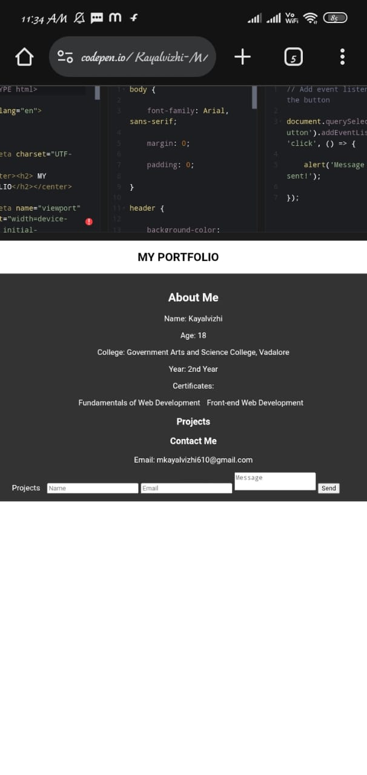
Results and Screen shorts

Slide 12
Conclusion
I’m very excited to create my own PPT for Naan Mudhalvan .
Thank You…

